Slide 1


Plate 1: (Top Dog Canine Hydrotherapy, 2015)
Kelly Page
FdSc in Animal Management Year 2
Work Practice 2
Notes:
Hello everybody, as you all know my name is Kelly Page and today I’m going to talk to you about where I’m going to be doing my 2nd year placement which this year is going to be top dog canine hydrotherapy.

Slide 2
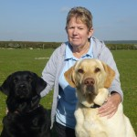
About my Placement
Canine hydrotherapy is a form of hydrotherapy directed at the treatment of chronic conditions, post-operative recovery and pre-operative or general fitness in dogs.
(Canine Hydrotherapy Association, 2014)
1. Founded by Maggie Cunniffe.
2. First facility opened in 2007.
3. ‘To improve or maintain your pets quality of life.’
4. Work with veterinary establishments in Southern England.
5. Member of the canine hydrotherapy association.
6. 3 qualified hydrotherapists.
Plate 2: (Top Dog Canine Hydrotherapy, 2015)
7. £40 per session.
8. Facilities include; small pool and water treadmill.
Notes:
- Firstly, a little bit about my placement. I’ve got a definition from the canine hydrotherapy association.
- To be a member of this association a branch needs to hold a nationally accredited qualification in hydrotherapy for small animals.
1. Top dog was founded by Maggie Cunniffe who is a kennel club breeder and breeds her own Labradors.
2. She opened top dog in 2007 in Andover and then due to the popularity she then established another branch in Newbury in 2011.
3. Their main aim at top dog is ‘to improve or maintain your pets quality of life’.
4. Top dog works alongside veterinary establishments across southern England.
5. They are a member of the canine hydrotherapy association as mentioned previously.
6. The Andover branch has 3 qualified hydrotherapists including Maggie.
7. They charge £40 per session.
8. Their facilities include a small pool and a under-water treadmill.

Slide 3
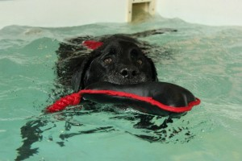
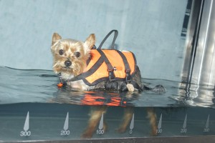
“He loves his weekly visit and we see a spring in his step after every visit. Thank you Top Dog.”
“The personal touch is what makes Top Dog stand out as not only a business but as a centre that genuinely love animals.”
Plate 3 + 4: (Top Dog Canine Hydrotherapy, 2015)
Notes:
Made a basic layout of the Andover branch.
To show you the popularity of top dog I have two testimonials written by previous clients.

Slide 4
My Targets
1. Learn at least 3 conditions that hydrotherapy can be referred to as a treatment.
2. Be able to fully work independently the water treadmill with a variety of different clients.
3. Learn the process of introducing a client to the hydrotherapy pool and monitor their session with a member of staff.
4. Be able to establish the different equipment involved with canine hydrotherapy.
5. Become more comfortable and confident handling clients in front of their owners over the three week period.
6. Become familiar with the advertising process that Top Dog undertake including veterinary practices, newspaper clips and the internet.
Notes:
Learn at least 3 conditions that hydrotherapy can be referred to as treatment.
To be able to work independently on the under-water treadmill with a variety of clients.
Learn the process of introducing clients to the small pool and monitor their session with the help of a qualified member of staff.
Be able to establish the different equipment involved within the sessions.
Become more confident in handling clients in front of their owners.
Learn the advertising process that top dog undertake such as through practices, newspaper clips and the internet.

Slide 5


First Year Placement
Plate 5: (Hart Wildlife, 2010)
Plate 6: (Anton Vets, 2014)
1. Domesticated animals preferably either dogs or birds.
2. Smaller business.
3. Something different from a veterinary establishment.
4. Animal health.
5. Search further afield.
6. Closer client connections.
7. Hydrotherapy centre's in veterinary establishments.
Notes:
I want to work with domesticated animals, preferably dogs or birds.
Prefer smaller business, more family like.
Done various work experiences in veterinary practices and wanted to try something different.
Still would like to be involved with the animal health side of things though as I find that interesting.
I’ve had to search further afield from home to find job roles that I would like to do.
I like to work closely with clients and get to know who I’m working for.
Hydrotherapy centres can be found within veterinary practices so is still much involved with that industry.

Slide 6


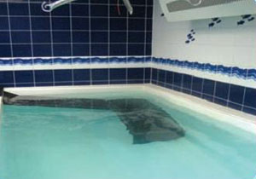
The Future
1. On the job training to become a qualified hydrotherapist.
2. Carry on working with Top Dog or join another hydrotherapy establishment.
3. Complete a short course on hydrotherapy to become qualified.
Plate 7: (White House Training Ltd, 2015)
4. Take my knowledge of the health side and apply it to nurse training.
5. Work alongside a veterinary establishment in a hydrotherapy unit.
Plate 8 + 9: (Mildmay Veterinary Centre, 2015)
Notes:
If I enjoy my work experience at top dog I could possibly go on to do on the job training to become a qualified hydrotherapist.
I could do this at top dog if they offer this or many other hydrotherapy facilities that offer training.
If that is not possible there are hydrotherapy short courses for hopeful hydrotherapists.
Picture 1: Whitehouse training is an establishment which offers courses in canine hydrotherapy and rehabilitation.
4. If known of that works out then if I continue to strive for a career in nursing I can apply the knowledge I have gained to that.
5. As mentioned previously, I could also be involved in both within a practice which as a hydrotherapy unit such as mildmay.

Slide 7
References
1. Anton Vets. (2014). Welcome to Anton Vets. Retrieved from Anton Vets: http://antonvets.co.uk/
2. Canine Hydrotherapy Association. (2014). Home. Retrieved from Canine Hydrotherapy Association: http://www.canine-hydrotherapy.org/
3. Hart Wildlife. (2010). About Hart. Retrieved from Hart Wildlife Rescue: http://www.hartwildlife.org.uk/
4. Mildmay Veterinary Centre. (2015). Hydrotherapy. Retrieved from Mildmay Veterinary Centre: http://www.mildmayvets.co.uk/hydrotherapy.html
5. Rolera LLC. (2015). Paw Print Clip Art. Retrieved from Free Clipart: http://www.clker.com/clipart-paw-print.html
6. Top Dog Canine Hydrotherapy. (2015). Home. Retrieved from Top Dog Canine Hydrotherapy: http://topdoghydrotherapy.com/
7. White House Training Ltd. (2015). Canine Hydrotherapy Training Courses. Retrieved from White House Training: http://www.caninehydrotherapytraining.co.uk/canine-hydrotherapy-training-courses.htm

